Slide 1
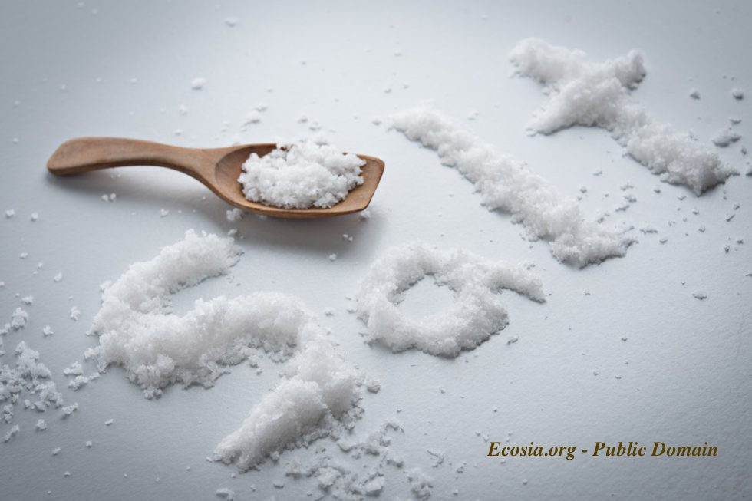
YOU ARE THE SALT OF THE EARTH

Slide 2
BELIEVERS ARE TO BE SALT AND LIGHT
¹³ “You are the salt of the earth; but if the salt loses its flavor, how shall it be seasoned? It is then good for nothing but to be thrown out and trampled underfoot by men.
¹⁴ “You are the light of the world. A city that is set on a hill cannot be hidden. ¹⁵ Nor do they light a lamp and put it under a basket, but on a lampstand, and it gives light to all who are in the house. ¹⁶ Let your light so shine before men, that they may see your good works and glorify your Father in heaven.

Slide 3
THE BEATITUDES - Restated

Slide 5
¹³ “You are the salt of the earth; but if the salt loses its flavor, how shall it be seasoned? It is then good for nothing but to be thrown out and trampled underfoot by men.

Slide 6
A Substance of Permanence
וְכָל־קָרְבַּ֣ן מִנְחָתְךָ֮ בַּמֶּ֣לַח תִּמְלָח֒ וְלֹ֣א תַשְׁבִּ֗ית מֶ֚לַח בְּרִ֣ית אֱ-לֹהֶ֔יךָ מֵעַ֖ל מִנְחָתֶ֑ךָ עַ֥ל כָּל־קָרְבָּנְךָ֖ תַּקְרִ֥יב מֶֽלַח׃
¹³ And every offering of your grain offering you shall season with salt; you shall not allow the salt of the covenant of your God to be lacking from your grain offering. With all your offerings you shall offer salt. (Lev 2:13 NKJV)

Slide 7
¹⁹ “All the heave offerings of the holy things, which the children of Israel offer to the Lord, I have given to you and your sons and daughters with you as an ordinance forever; it is a covenant of salt forever before the Lord with you and your descendants with you.” (Numbers 18:19 NKJV)
⁵ Should you not know that the Lord God of Israel gave the dominion over Israel to David forever, to him and his sons, by a covenant of salt? (2 Chronicles 13:5 NKJV)

Slide 8
SALT AS A TASTE ENHANCER
Chinese wars over salt 4,000 BC
Creation of original “soy sauce”
Turning the bland into something tasty
A little goes a long way
Caesar’s Salad
Parallel Function of the Believer

Slide 9
SALT AS A PRESERVATIVE
Creation of Empires
YOU ARE THE SALT OF THE EARTH! We are the preservative of God’s love and grace in the world.
YOU ARE THE SALT OF THE EARTH! WE ARE TO PRESERVE HOPE IN A DYING HOPELESS WORLD.

Slide 10
SALT AS A CURATIVE FOR THE BODY
Here are five simple signs by which your body might be telling you that salt is needed:
Dizziness
Fatigue
Brain fog
Headaches
Muscle spasms
YOU ARE THE SALT OF THE EARTH! WE ARE TO CARRY THE CURE FOR SIN TO A DYING HOPELESS SINFUL WORLD.

Slide 11
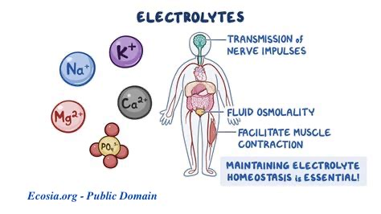
SALT IS THE GREAT CONDUCTOR – IT IS A CONNECTOR

Slide 12
2 Corinthians 5
¹⁸ Now all things are of God, who has reconciled us to Himself through Jesus Christ, and has given us the ministry of reconciliation, ¹⁹ that is, that God was in Christ reconciling the world to Himself, not imputing their trespasses to them, and has committed to us the word of reconciliation.
²⁰ Now then, we are ambassadors for Christ, as though God were pleading through us: we implore you on Christ’s behalf, be reconciled to God. ²¹ For He made Him who knew no sin to be sin for us, that we might become the righteousness of God in Him. (2 Corinthians 5:18-21 NKJV)

Slide 13
The BIG IDEA:
YOU AND I AND ALL OTHER BELIEVERS ARE THE SALT OF THE EARTH! WE ARE TO COMMUNICATE AND BE THE CONDUIT OF GOD’S LOVE, MERCY, GRACE, AND RECONCILIATION TO A DYING HOPELESS WORLD.

