Slide 1
PSALMS 51:
FREEDOM FROM GUILT
Union Grove Baptist Church
August 9, 2026

Slide 2
GUILT!

Slide 3
For godly grief produces a repentance that leads to salvation without regret, whereas worldly grief produces death.
2 Corinthians 7:10

Slide 4

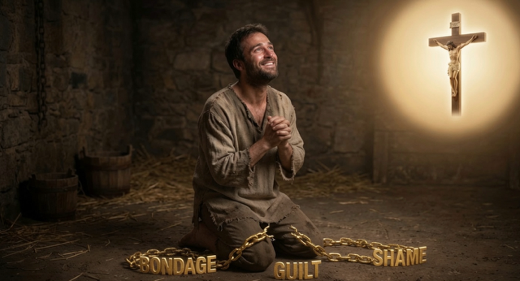

Slide 5
1 Have mercy on me, O God,
according to your steadfast love;
according to your abundant mercy
blot out my transgressions.
2 Wash me thoroughly from my iniquity,
and cleanse me from my sin!
3 For I know my transgressions,
and my sin is ever before me.

Slide 6
4 Against you, you only, have I sinned
and done what is evil in your sight,
so that you may be justified in your words
and blameless in your judgment.
5 Behold, I was brought forth in iniquity,
and in sin did my mother conceive me.
6 Behold, you delight in truth in the inward being,
and you teach me wisdom in the secret heart.

Slide 7
7 Purge me with hyssop, and I shall be clean;
wash me, and I shall be whiter than snow.
8 Let me hear joy and gladness;
let the bones that you have broken rejoice.
9 Hide your face from my sins,
and blot out all my iniquities.
10 Create in me a clean heart, O God,
and renew a right[b] spirit within me.

Slide 8
11 Cast me not away from your presence,
and take not your Holy Spirit from me.
12 Restore to me the joy of your salvation,
and uphold me with a willing spirit.
13 Then I will teach transgressors your ways,
and sinners will return to you.
14 Deliver me from bloodguiltiness, O God,
O God of my salvation,
and my tongue will sing aloud of your righteousness.

Slide 9
15 O Lord, open my lips,
and my mouth will declare your praise.
16 For you will not delight in sacrifice, or I would give it;
you will not be pleased with a burnt offering.
17 The sacrifices of God are a broken spirit;
a broken and contrite heart, O God, you will not despise.

Slide 10
18 Do good to Zion in your good pleasure;
build up the walls of Jerusalem;
19 then will you delight in right sacrifices,
in burnt offerings and whole burnt offerings;
then bulls will be offered on your altar.

Slide 12
God's mercy is greater than our sin.
True repentance involves honesty because sin is first and foremost against God and He knows the truth.
God desires inward transformation, not outward words.
A broken and contrite heart pleases God.
5. The Holy Spirit is essential in the process of forgiveness.

Slide 13
God's mercy is greater than our sin.
Have mercy on me, O God, according to your steadfast love; according to your abundant mercy blot out my transgressions. Wash me thoroughly from my iniquity, and cleanse me from my sin! For I know my transgressions, and my sin is ever before me.
Psalms 51:1-3

Slide 14
Therefore, I tell you, every sin and blasphemy will be forgiven people, but the blasphemy against the Spirit will not be forgiven. And whoever speaks a word against the Son of Man will be forgiven, but whoever speaks against the Holy Spirit will not be forgiven, either in this age or in the age to come.
Matthew 12:31-32

Slide 15
True repentance involves honesty with God
because sin is first and foremost against God.
Against you, you only, have I sinned and done what is evil in your sight, so that you may be justified in your words and blameless in your judgment.
Psalms 51:4

Slide 16
Biblical repentance is more than just feeling guilt or shame; it’s a deliberate turning toward God that produces a changed life.

Slide 17
God desires inward transformation in our lives,
not just outwardly changing our actions.
Behold, you delight in truth in the inward being, and you teach me wisdom in the secret heart. Purge me with hyssop, and I shall be clean; wash me, and I shall be whiter than snow. Let me hear joy and gladness; let the bones that you have broken rejoice. Hide your face from my sins, and blot out all my iniquities. Create in me a clean heart, O God, and renew a right spirit within me.
Psalms 51:6-10

Slide 18
God truly desires a broken and contrite heart.
Deliver me from bloodguiltiness, O God, O God of my salvation, and my tongue will sing aloud of your righteousness. O Lord, open my lips, and my mouth will declare your praise. For you will not delight in sacrifice, or I would give it; you will not be pleased with a burnt offering. The sacrifices of God are a broken spirit; a broken and contrite heart, O God, you will not despise.
Psalms 51:14-17

Slide 19
A broken and contrite heart describes a person
who has been brought to genuine humility
before God because of their sin

Slide 20
For godly grief produces a repentance that leads to salvation without regret, whereas worldly grief produces death.
2 Corinthians 7:10

Slide 21
There is therefore now
no condemnation
for those who are in Christ Jesus.
Romans 8:1

Slide 22
There is therefore now
no condemnation
for those who are in Christ Jesus.
Romans 8:1

Slide 23
The work of the Holy Spirit is essential
to this process of healing.
Cast me not away from your presence, and take not your Holy Spirit from me. Restore to me the joy of your salvation, and uphold me with a willing spirit.
Psalms 51:11-12

Slide 24
The Holy Spirit Produces Inner Transformation.
Then I will teach transgressors your ways, and sinners will return to you. Deliver me from bloodguiltiness, O God, O God of my salvation, and my tongue will sing aloud of your righteousness.
Psalms 51:13-14

Slide 25
God graciously forgives and restores those who come to Him in genuine repentance, humility, and faith. Confession is not merely about admitting our wrongdoing but about seeking a transformed heart that delights in obeying God..

Slide 26
For Christians, Psalm 51 also points forward to our complete cleansing made possible through Jesus Christ, whose sacrifice provides the forgiveness and renewal for which David longed, and we also long to see

