Slide 1
Courage!
The Courage to Stand!

Slide 2
Have I not commanded you? Be strong and courageous. Do not be frightened, and do not be dismayed, for the LORD your God is with you wherever you go.
Joshua 1:9

Slide 3
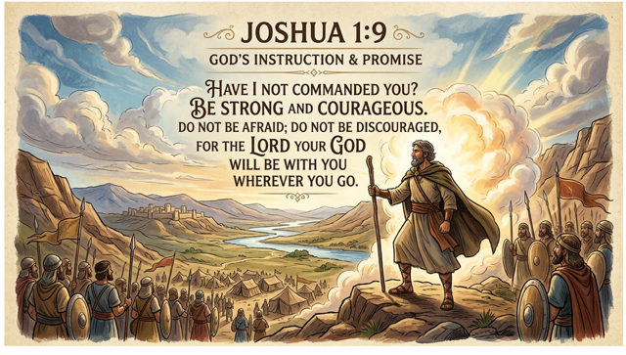

Slide 4
To know what is right, and to fail to do that which is right, is the greatest form of cowardice.
Buddy McCaig

Slide 5
Courage is not the absence of fear.
Moral courage is one of the greatest tests of Christian faith
True courage comes from trusting God; not from within

Slide 6
Fear not!

Slide 8
You come to me with a sword and with a spear and with a javelin, but I come to you in the name of the LORD of hosts.
1 Samuel 17:45

Slide 9
Moral Courage Is the greater challenge over physical courage.
We understand what happens “after.”

Slide 10
He got down on his knees three times a day and prayed and gave thanks before his God, as he had done previously.
Daniel 6:10

Slide 11
Difficult circumstances don’t create character.
They reveal character.

Slide 12
One who is faithful in a very little
is also faithful in much.
Luke 16:10

Slide 13
True courage comes from trusting God!
"Fear not, for I am with you; be not dismayed,
for I am your God.
Isaiah 41:10

Slide 14
You are not standing alone!
I can do all things through him who strengthens me.
Philippians 4:13

Slide 15
History may remember courageous people. But heaven honors faithful people. The courage God wants us to have is not merely heroic action in extraordinary moments. Its faithful obedience in everyday life. It’s the courage to do right when nobody is watching. It’s the courage to speak truth when silence would be easier.
It’s the courage to stand firm when compromise seems attractive. It’s the courage to trust God when circumstances seem overwhelming. The world desperately needs people of moral courage. Families need them. Churches need them. Communities need them. And the Kingdom of God certainly needs them.

