Slide 1
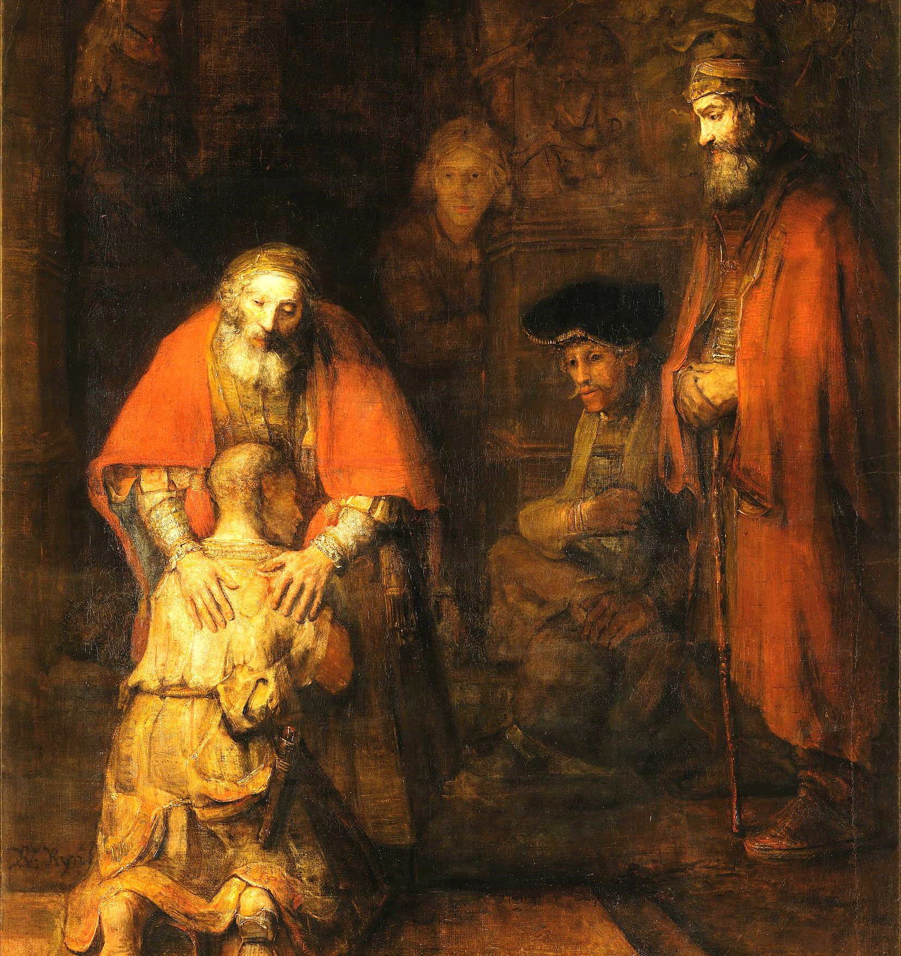
The Parable of the Prodigal in Three Parts
Luke 15:11-32
Part Three:
The Father
Notes:
Last message
We will touch on all three characters
Yet we will focus on the Father. He ties the story together
Ask the congregation
Once again, place yourself into the parable
Who are you most like?
***This is a parable, not a parenting manual
Not a “step by step” guide
Seek for wisdom in applying this parable

Slide 2
Context
Two opposite groups prompted the parable 11:1-3
  Tax collectors & sinners
  Pharisees & teachers of the law
Jesus’ coming kingdom shook the foundation of their religion
  No longer was one bad; the other good
  Both were outside the kingdom
  Both were invited in
Notes:
Two opposite groups prompted the parable
If we stretched a line across the sanctuary to represent them, I bet you could place yourself on that line
Jesus’ coming kingdom shook the foundation of their religion
Remember the line I mentioned a moment ago?
Jesus took it down

Slide 3
God as Father
Hallmark of Jesus’ ministry
  Model prayer: “Our Father, who art in heaven”
  Sermon on the Mount: God called “Father” 17 times
Not the only title for God (Isa. 43:15)
  Lord
  Holy One
  Creator
  King
But “Father” is the one we hold dear
Notes:
Title for God used 17 times in Sermon on the Mount
Conversely, God is represented as Father perhaps 20 times all of the OT

Slide 4
The Father’s Love: Same for Both Boys
Younger Son
Older Son
Runs to meet him 11:20
Has compassion on him
Does not criticize, shame, punish
Is generous 11:22
Let’s celebrate 11:23
Brings son inside
Loves enough to let him leave
Goes out to meet him 11:28
Pleads with him
Does not defend, rebuke, criticize
“Everything…is yours” 11:31
Come celebrate 11:28
Invites son inside
Loves enough to let him stay outside

Slide 5
Father’s Love and the Younger Son’s Leaving
Love that the father gives
  Hurts
    Insult 11:12
    Grief
    Foreboding
  Is costly
    All his resources
    Peace in his family
Loves enough to let his son go
Loves with no guarantee of return
Yet remains hopeful 11:20b

Slide 6
Father’s and the Younger Son’s Return
Unconditional love
Complete forgiveness
Costly—again (robe, ring, sandals, feast)
Criticism will fall on the father
Notes:
Any of criticism will fall on the father
Who did the older son attack? The father

Slide 7
Father’s Love and Older Son
Father humbles himself (pleads) 11:28
Doesn’t contradict the son’s judgment of his brother 11:30
Never rebukes his accusations against the father . 11:29-30
Reminds him of his constant love & bounty 11:31
Reminds him of love and forgiveness 11:32
Reminds him that he has a brother
Notes:
Read 11:28-32 again
The older son shouts at his father
The quiet voice of the father rings far louder
Conclusion
The son deserved to be contradicted, rebuked; put in his place
Just like the young son
The father chooses not to exercise these rights
Mercy
Understanding
Grace; opportunity for the son to come home

Slide 8
Unconditional Love
Father’s love is not dependent on behavior
The younger
  His sin did not ruin the Father’s love
  His return did not earn it either*
The older
  His obedience did not earn love
  His hatred did not destroy it
Notes:
His return did not earn it either
*It enabled it, but did not earn it

Slide 9
[Hidden Slide] When I Reflect on this Story
I feel deeply unworthy
  As both the younger son and the older
  Unworthy to stand and proclaim it to you
But as I listen to the Father through the story, I hear something different
  I am beloved
  Not for what I have or haven’t done
  But because the Father invites me home
I am his beloved child

Slide 10
Life Lessons
In the Father’s love we can…
  Leave or return
  Be angry or humble
  Waste our inheritance
  Blindly believe obedience will gain his favor
  Stubbornly refuse to love
For all our faults, he waits for us to come home to the party
Notes:
Life Lessons
***Don’t start packing, yet. The Big Idea is yet to come
C o n c l u s i o n
I am not saying our choices have no consequences
They can be eternal
I am saying God’s love allows us to choose

Slide 11
One Step Beyond
Who have you related to the most?
I will push a bit
  Can you stand in the Father’s place?
  Love when it costs deeply
    Love enough to let them choose to go
    Forgive
    Take no offence at wrongs
    Humble yourself to listen when criticized
    Welcome them home without reproach
And celebrate

Slide 12
The Big Idea
To Love as the Father
Is to Be Godly

